Slide 1
DDA/IVA/ISA/Insert Acronym Here Initial Setup Overview

Slide 2






Typical ISA Setup
SmartRep
Many : 1 Relationship
slide.json
keymessage.json
Veeva

Slide 3
Slide.json
{
"id": 1,
"name": "humira_gastro_content_grid_00",
"description": "Home",
"keymessage": [1],
"template": [],
"template_ajax": [],
"js": [],
"less": []
},
- Unique ID for each entry (just incremented)
- Part of the keymessage id in Salesforce
- What the slide will be called in Veeva
- Which keymessage.json entry to use
- Template files for the slide
- No idea!
- Javascript files for the slide
- Less files for the slide
SmartRep
Keymessage.json
{
"id": 1,
"product": "AbbVie Humira Gastro IVA",
"product_id": "a00O000000VGbVA",
"clm_presentation":
"abbvie_humira_gastro_content_grid_00",
"presentation_version": "01",
"display_order": "0",
"active": true,
"slide_version": "1"
},
- Unique ID for each entry (just incremented)
- Name of the product for the slide
- Product ID in Salesforce, taken from the URL
- Presentation name associated with the slide
- Version of the presentation
- Display order for the slide in the presentation
- Should always be true
- Version of the slide
As far as I know, items in this color are irrelevant!

Slide 4
Presentation.json
{
"id": 1,
"name": "abbvie",
"bodyclass": "",
"slide": [],
"template":[],
"less":[],
"js":[]
}
- Unique ID for each entry (just incremented)
- Part of the keymessage id in Salesforce
- Add a class to the body in all slides
- Order slides should appear in SmartRep
- Template files for the presentation
- Javascript files for the presentation
- Less files for the presentation
SmartRep
The keymessage id in Salesforce is created in SmartRep by combining the Presentation.json name with each Slide.json name, connected with underscores: abbvie_humira_gastro_content_grid_00.zip

Slide 5
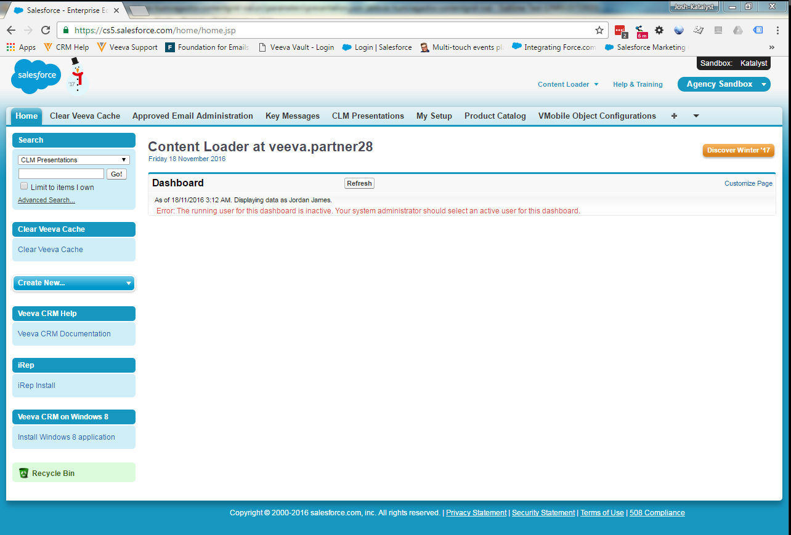
SalesForce - Overview
This is where SmartRep sends our Slides
This is where we need to set up the presentation
And this is where we set up the product for the ISA
If you don’t see these tabs, click here for the full tab list!

Slide 6
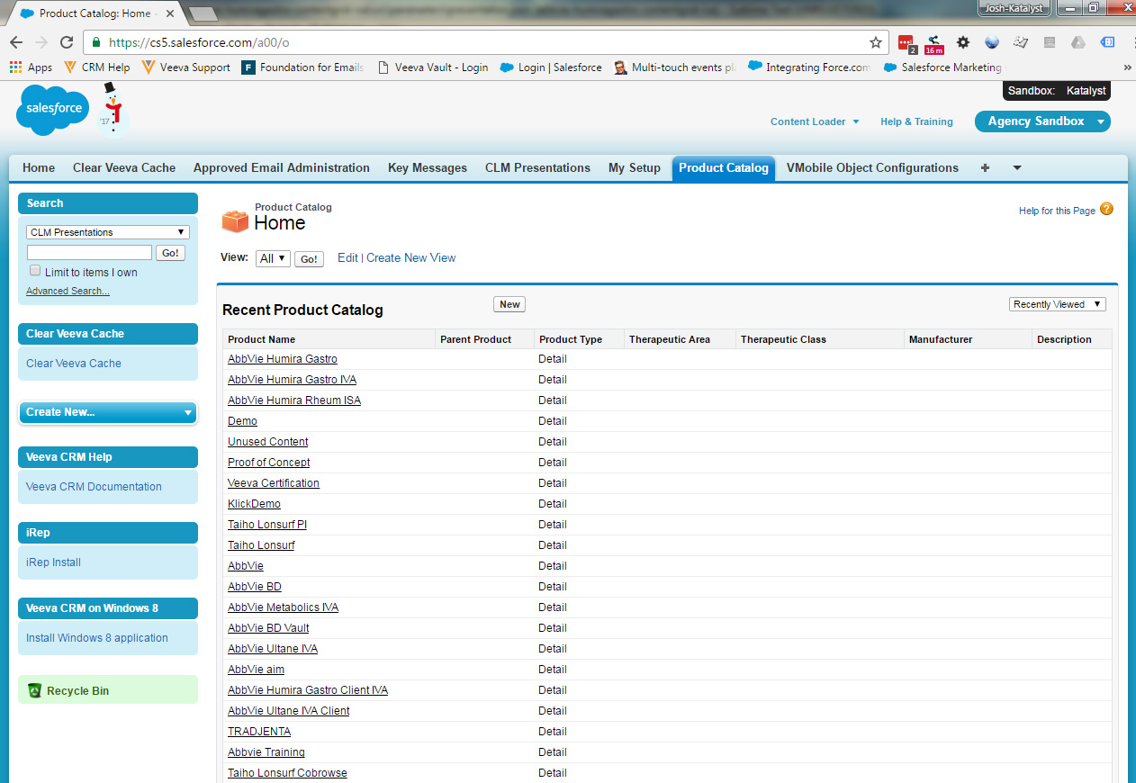
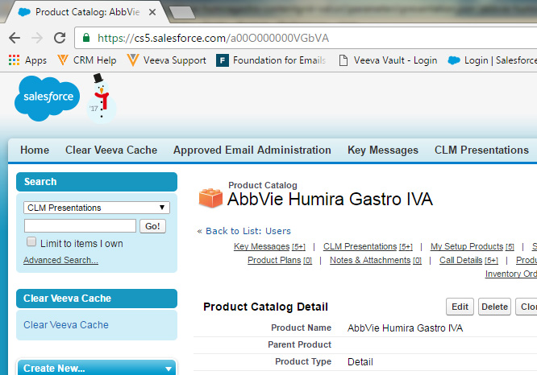
SalesForce – Product ID
To find the product ID, click the product you want to use to open it’s details page.
The ID we need for our keymessage.json is the string at the end of the URL. For AbbVie Humira Gastro IVA, the string is “a00O000000VGbVA”

Slide 7
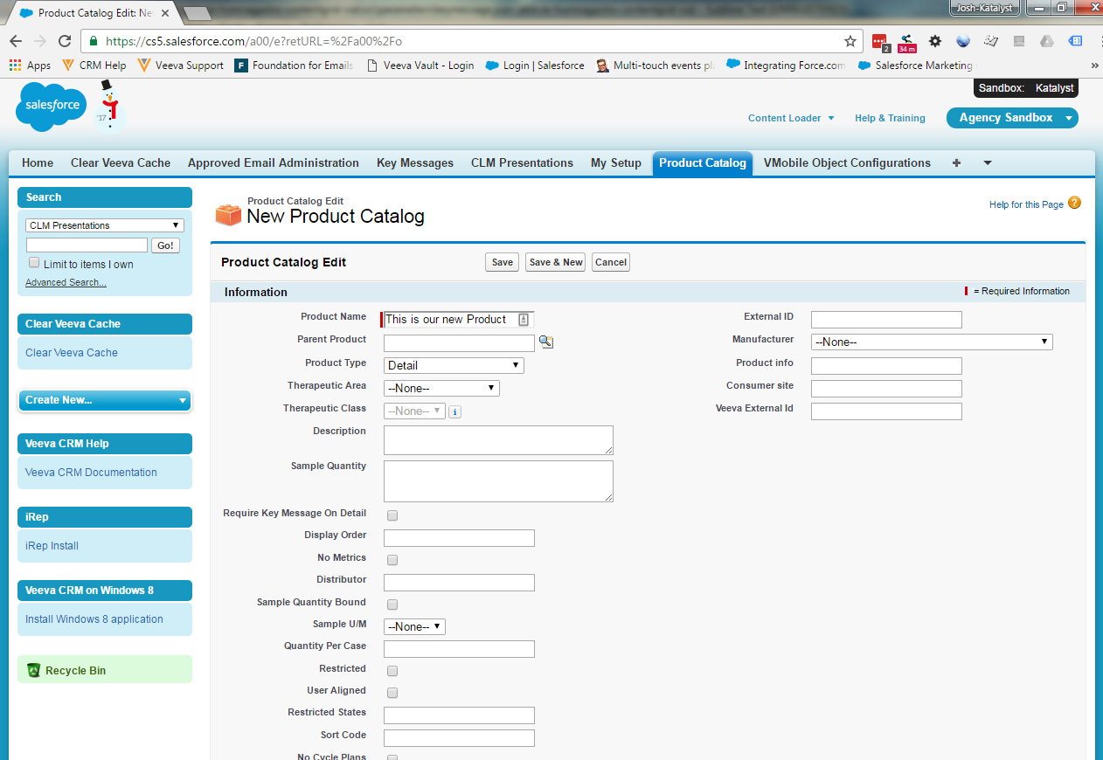
SalesForce – New Product
To create a new Product, press “New” on the product Catalog page. It will take you to the New Product Catalog page.
Enter the name you want to use for the new product
For ISAs, the Product Type should be set to Detail.
Only the 2 fields need to be completed to create a valid product.
When you hit save, it will take you to the product page for your new product, where you can grab the ID from the URL
You will need to get your new product setup with an account for syncing to Veeva. Let the CRM team know which product and which login you are using, and they can create the association for you.

Slide 8
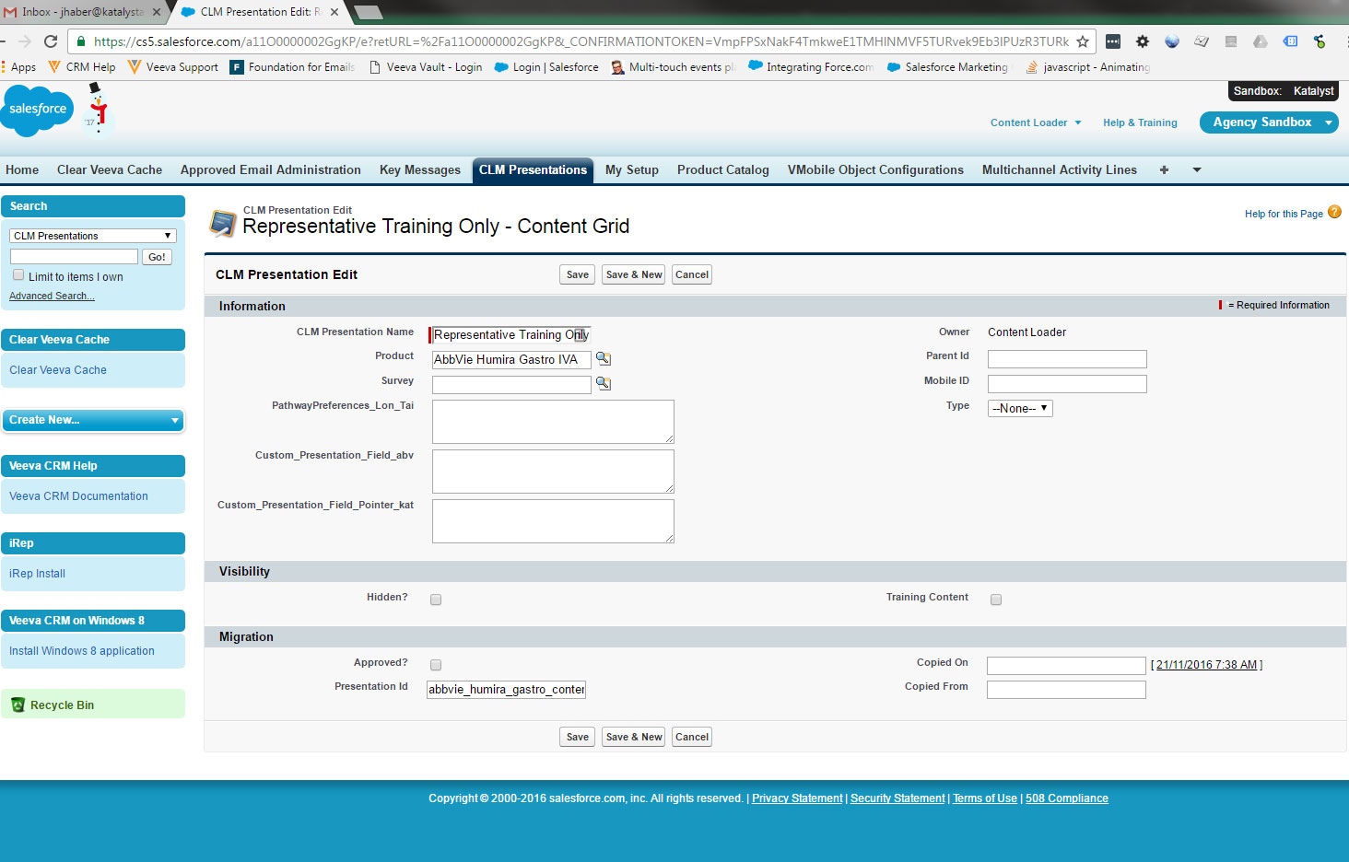
SalesForce – New Presentation
Enter the display name for the presentation. This is what it will be called in Veeva
Select the product we previously set up for our Presentation
Enter the id for the presentation. We usually select something similar to the slide ids. Ex: Presentation id could be abbvie_humira_gastro_content_grid
and the slide ids would be
abbvie_humira_gastro_content_grid_00,
abbvie_humira_gastro_content_grid_01, etc.

Slide 9
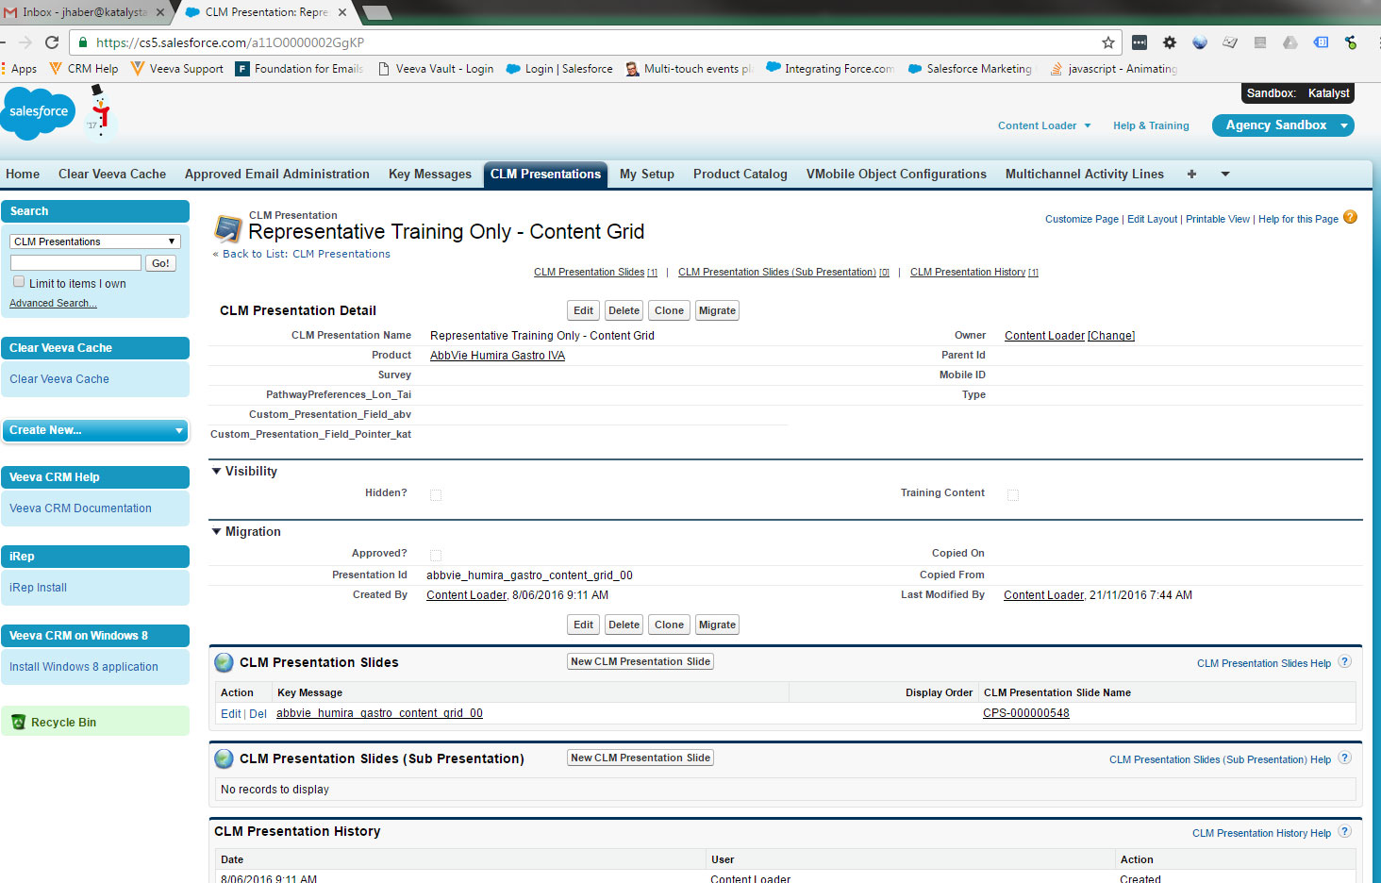
SalesForce – Adding Slides
After saving the presentation, you should land on the presentation page. Find the CLM Presentation Slides section to add slides to the presentation

Slide 10
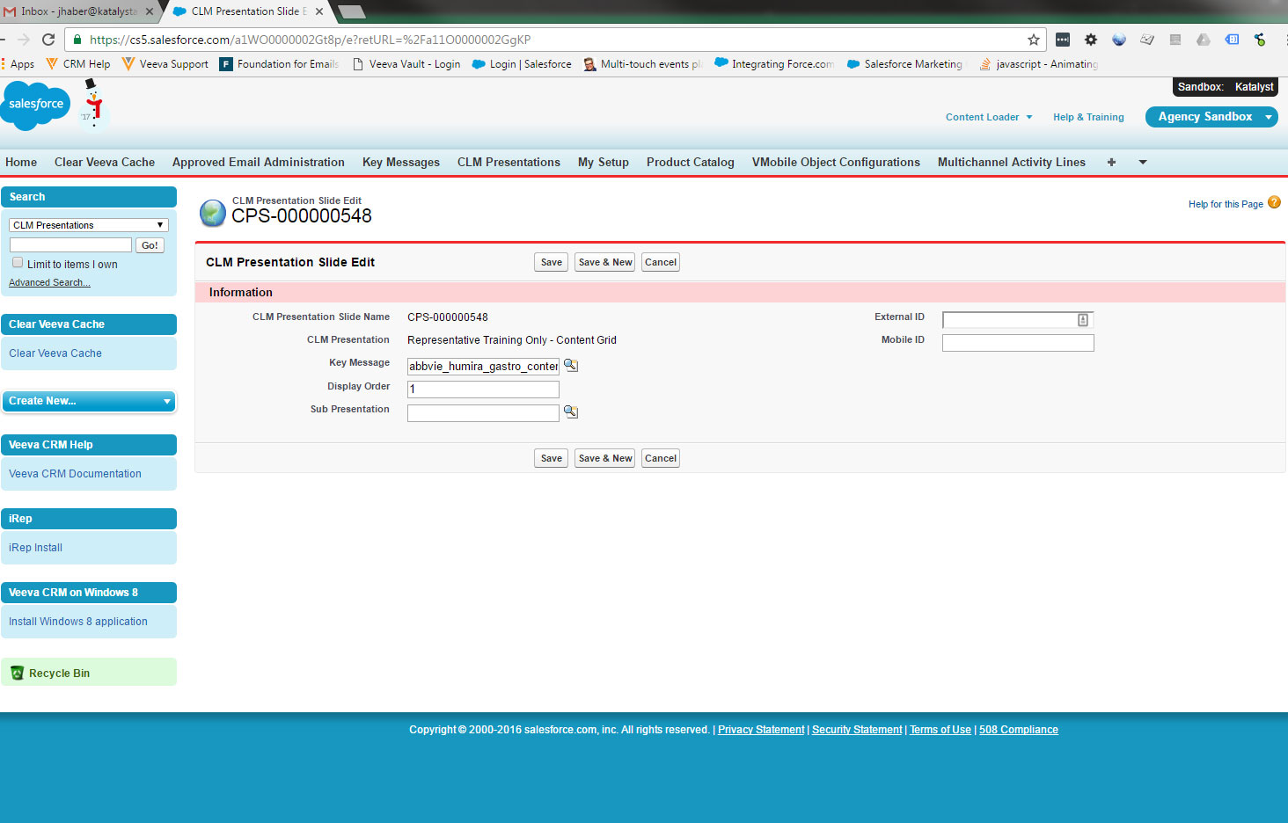
SalesForce – Adding Slides
Enter the keymessage (slide) id that you want to add (or use the search button to find it)
Enter the order that the slide should appear in the presentation.
A sub presentation, if set, shows up automatically before your slide can be viewed in Veeva. It is generally used for forcing an ISI or other safety content to be viewed for regulatory purposes.
To use it, your required content needs to be set up in it’s own presentation and the sub presentation needs to be set for each slide where the required content should show up.

Slide 11
Typical ISA Setup
SmartRep
Many : 1 Relationship
slide.json
keymessage.json
Veeva

Slide 12


Typical ISA Setup
SmartRep
1 : 1 Relationship
slide.json
keymessage.json
config.json
1 : Many Relationship
(1 per ISA)
Veeva
Custom Field

Slide 13
Slide.json
{
"id": 1,
"name": "humira_gastro_cd_00",
"description": "Home",
"keymessage": [1],
"template": [],
"template_ajax": [],
"js": [],
"less": []
},
- Unique ID for each entry (just incremented)
- Part of the keymessage id in Salesforce
- What the slide will be called in Veeva
- Which keymessage.json entry to use
- Template files for the slide
- No idea!
- Javascript files for the slide
- Less files for the slide
SmartRep
Keymessage.json
{
"id": 1,
"product": "AbbVie Humira Gastro IVA",
"product_id": "a00O000000VGbVA",
"clm_presentation":
"abbvie_humira_gastro_cd_00",
"presentation_version": "01",
"display_order": "0",
"active": true,
"slide_version": "1"
},
- Unique ID for each entry (just incremented)
- Name of the product for the slide
- Product ID in Salesforce, taken from the URL
- Presentation name associated with the slide
- Version of the presentation
- Display order for the slide in the presentation
- Should always be true
- Version of the slide
As far as I know, items in this color are irrelevant!

Slide 14
Presentation.json
{
"id": 1,
"name": "abbvie",
"bodyclass": "",
"slide": [],
"template":[],
"less":[],
"js":[]
}
- Unique ID for each entry (just incremented)
- Part of the keymessage id in Salesforce
- Add a class to the body in all slides
- Order slides should appear in SmartRep
- Template files for the presentation
- Javascript files for the presentation
- Less files for the presentation
SmartRep
The keymessage id in Salesforce is created in SmartRep by combining the Presentation.json name with each Slide.json name, connected with underscores: abbvie_humira_gastro_cd_00.zip

Slide 15
Config.json
Tells the boilerplate where to look for saved presentation data (such as custom presentations) in the Salesforce DB.
- customField is deprecated and should be blank
- customFieldPointer should always be set as seen here. The specific field is set in Salesforce in the Presentation data.
{
"customField": "",
"customFieldPointer": "Custom_Presentation_Field_abv__c",
"tileData":[
{
"id": 1,
"veevaPresentation":
"abbvie_humira_gastro_cd_01",
"veevaKeymessage":
"abbvie_humira_gastro_cd_01.zip",
"text":
"Indications & Safety Considerations" },
.
.
.
Etc.
],
}
This data tells the boilerplate which Salesforce fields contain the presentation and slide files we want to use. If any of this does not perfectly match the IDs in salesforce, the boilerplate will fail to run the presentation.
We set up a presentation in Salesforce for EACH slide we are using. The config should have an entry for each slide-presentation pair with:
- veevaPresentation: The exact ID for the presentation in Salesforce
- veevaKeymessage: The exact ID for the slide in Salesforce (the media file uploaded is the slide ID, so it always ends in .zip)
- text: The name of the slide that shows up in the boilerplate. Should match Slide.json description
SmartRep Boilerplate

Slide 16
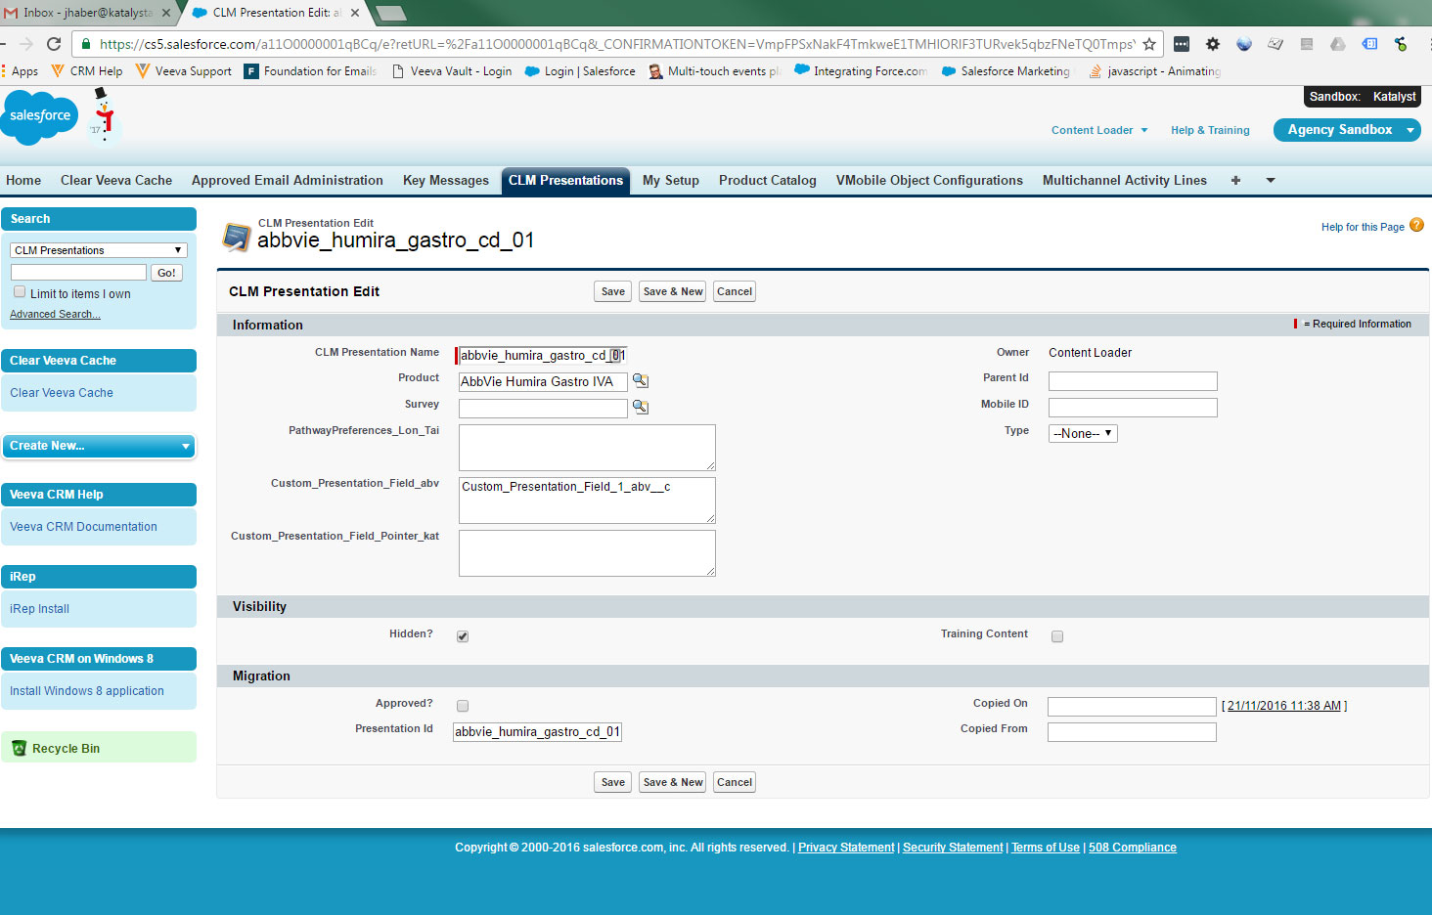
SalesForce – New Presentation
Enter the display name for the presentation. This is what it will be called in Veeva. Usually only the first slide matters (id 00), which should have a name relative to the content (Crohn’s ISA). All other slides can have a name that matches their ID so they are easy for us to search for.
Since boilerplate requires each slide to have it’s own presentation, each slide would then appear separately in Veeva. To prevent this, we always have an initial slide (usually id 00) which is just the boilerplate. All other slides need to be set to hidden so they cannot be accessed without first going to the Home slide.
Enter the name of the custom field set up specifically for the ISA.
Enter the id for the presentation. This is usually set to match the keymessage ID.
Example:
Keymessage: abbvie_humira_gastro_cd_01.zip
Presentation: abbvie_humira_gastro_cd_01

Slide 17
SalesForce – Custom Fields?
What are custom fields?
Config.json points to Custom_Presentation_Field_abv which points to the required field for the ISA. This allows AbbVie to custom set their own field so we don’t have to access their environment for each new ISA we build.
Custom fields are text area entries into the database that are stored on the User object.
An encrypted string of data is created in Veeva when a user interacts with the boilerplate, and when there is an internet connection, the data is uploaded into Salesforce for storage.
If a user changes devices and logs in with the same account, their data will be downloaded to their new device so the experience is consistent (at this time, this mostly consists of custom presentation data)
Since the data is stored on the User object, each user has their own unique set of data.
Each ISA needs it’s own custom field. If a user has access to more than one of our boilerplate ISAs, the data from one would corrupt the other if they shared the same field.
There are limits to the amount of custom field data (in characters) we can store. Each field has a limit, but also each User has a maximum across all fields. We may eventually run into issues with this, but that is a little ways away.
For the moment, you should reach out to the CRM team if you need to add a new custom field to our Salesforce environment.

Slide 18
SalesForce – Adding Slides
Enter the keymessage (slide) id that you want to add (or use the search button to find it)
Since each presentation only has one slide, this should always be set to 1 or can be left blank. Boilerplate handles the slide order for us.
The required slide should NOT be set here. We have our own required slide functionality in the Boilerplate, and this will not work properly.

